Slide 1
Jester and Eigentaste
Progress Summary

Slide 2
Gauge Set Optimization
Identify a new gauge set with better performance
Reduce the number of jokes in the gauge set
Based on the assumption that users find it tiring/annoying to rate lots of jokes, and that a smaller gauge set might lead to higher retention rates

Slide 3
Results
Method | Mean | Median | Joke(s) Used
10 Joke PCA | 0.2022 | 0.2010 | Original Gauge
Single Joke | 0.1995 | 0.1968 | 39
Six Joke (Two at a Time) | 0.1869 | 0.1837 | Mean: 14, 21, 26, 28, 38, 39
 |  |  | Median: 14, 26, 28, 38, 39, 61
Six Joke (One at a Time) |  | 0.1871 | 14, 26, 28, 38, 39, 61

Slide 4
Dead Zone (Inlier Removal)
Users who are undecided pick low valued rating
Removing these users may improve results
Removal of inliers causes data shedding, which impacts performance
In every case, inlier removal performs worse

Slide 5
Results
Method | Mean | Dead Zone | Jokes Used | Data Discarded
Six Joke (One at a time) | 0.2225 | [-1, 1] | 21, 38, 39, 42, 48, 61 | 9.8%
Six Joke (Two at a time) | 0.1886 | [-2, 2] | 14, 21, 26, 28, 38, 39 | 18%
Six Joke (One at a time) | 0.2447 | [-3, 3] | 15, 21, 39, 48, 49, 66 | 26%

Slide 6
K-Means Clustering
Allows clustering in higher dimensions
Can experiment with larger number of clusters
Measure the impact of dimensionality on NMAE

Slide 7
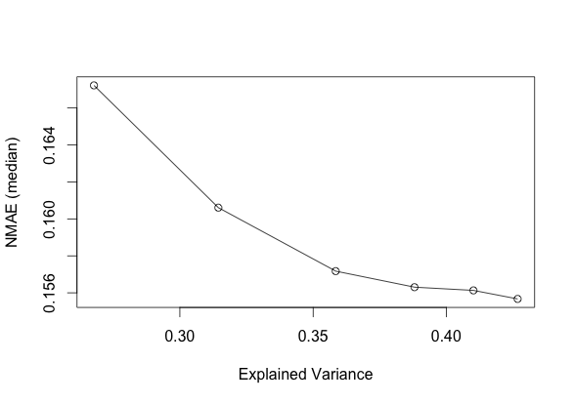
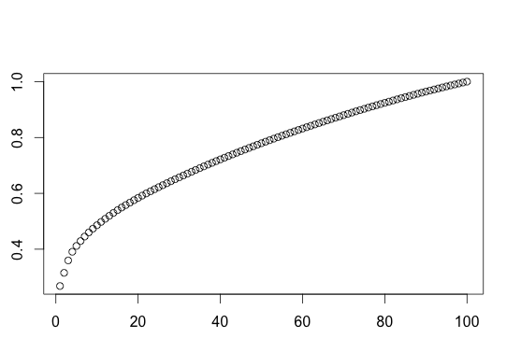
Results
Explained variance
# of dimensions

Slide 8
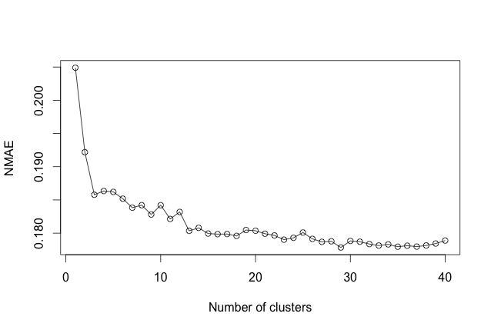
Results

Slide 9
Results
Clustering Technique | Gauge Set | NMAE | Improvement
Recursive Clustering | 14, 26, 28, 38, 39, 61 | 0.1837 | -
K-Means | 14, 26, 28, 38, 39, 61 | 0.178 | 3%
K-Means | Entire Dataset | 0.162 | 12%

Slide 10
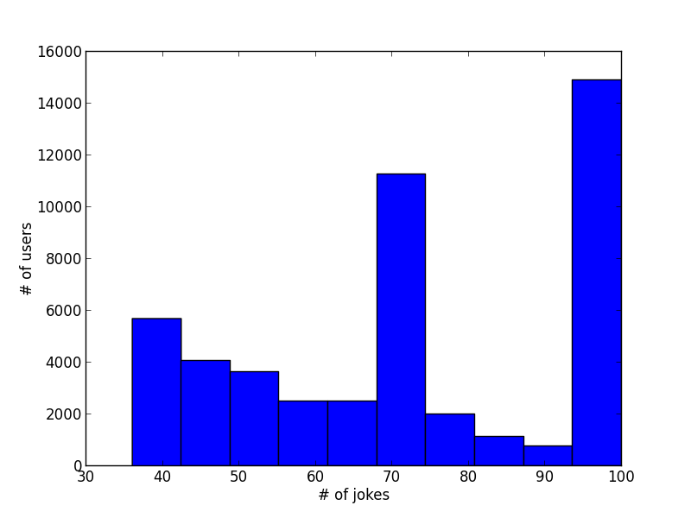
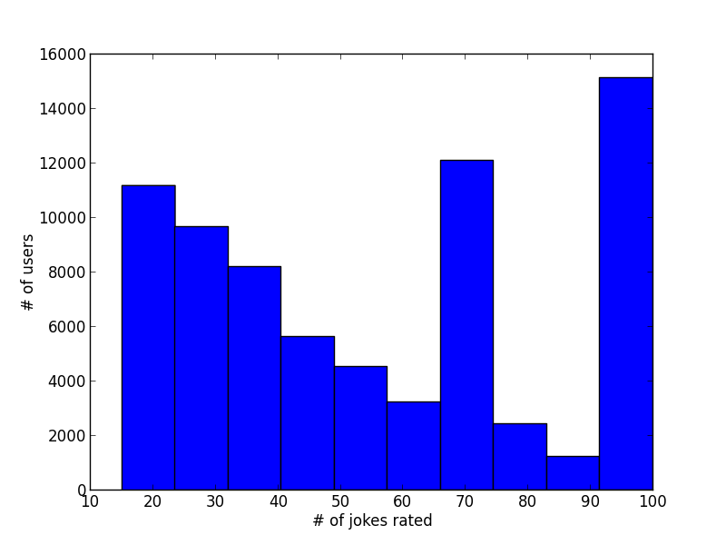
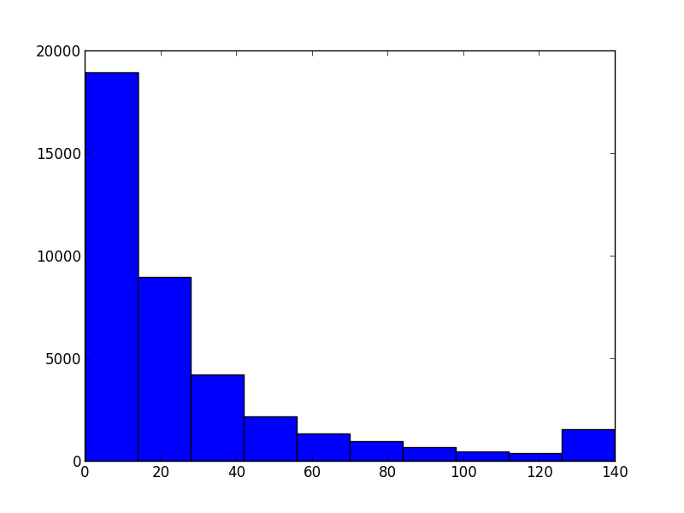
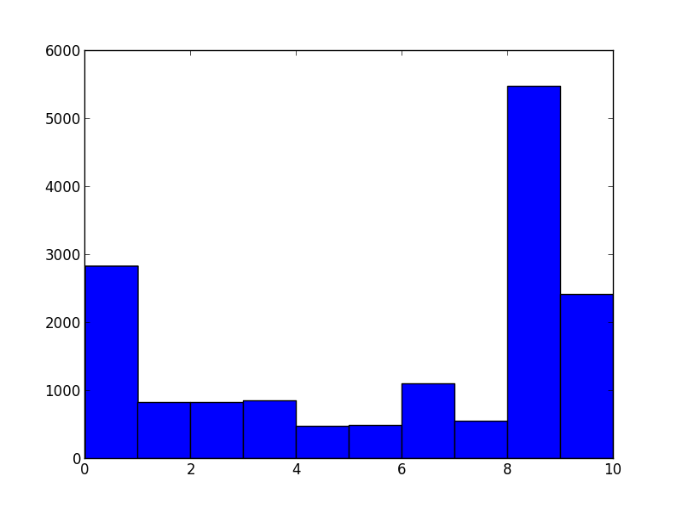
Data Set Exploration
Compilation of Dataset 1 (includes data used by Jared)
Raw data
Raw Data (# of jokes = 1 - 10)
Dataset used by Jared

Slide 11
Results
Dataset used by Jared only includes users who rated more than 36 jokes
Even the entire Dataset only contains users who rated more than 15 jokes
Large number of users who rated all 100 jokes
Distribution of raw data seems more plausible

Slide 12
Future Work
Data Cleaning
SampleClean
Full Cleaning
Jester Redesign
Website Redesign
Modify System (# of Gauge set jokes, order of recommendations, online cleaning …)

